Slide 1
Gloria FDCG- EA Certification material

Slide 2
Content
High level Concept Model reflecting agreed scope and definitions
To Be Architectural Map
Gloria - Component model
Gloria -
Gloria - High Level Deployment view

Slide 3
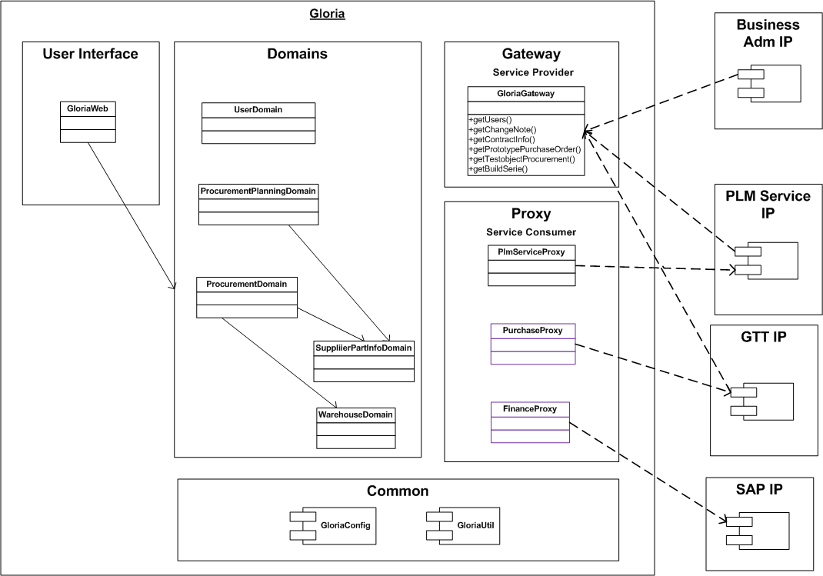
Gloria Component Model

Slide 4
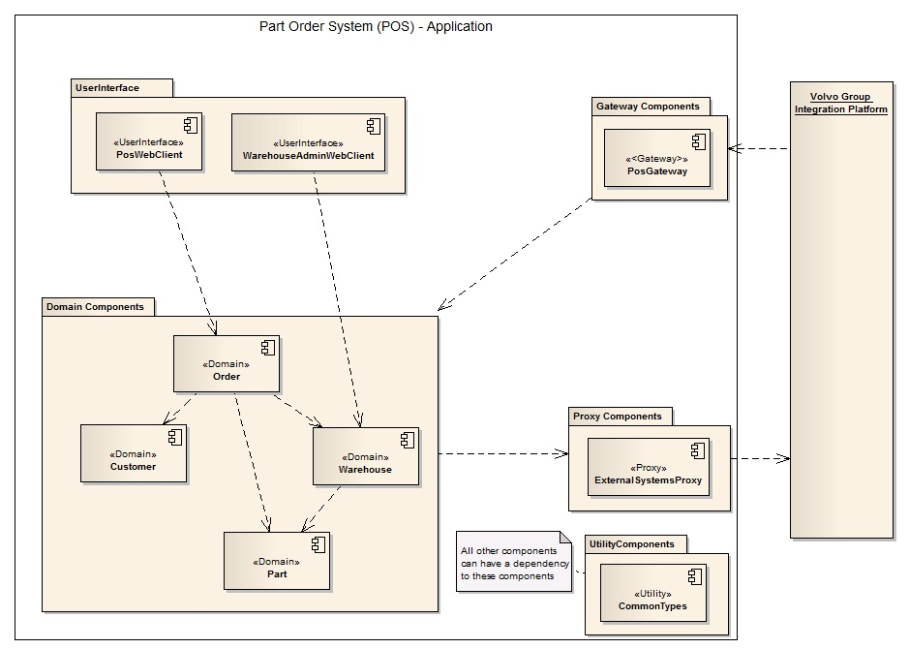
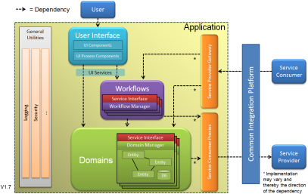
Sample Application Component Model
Note: UML Notation should be used
Sample POS Domain Model

Slide 5
High Level Deployment View

Slide 6
High Level Deployment View
Note: The deployment view should only be detailed enough to show important conecpts.
E.g. In the view to the right there are two nodes highlighting the need of load balancing.

